Slide 1
Bike Sharing Demand Prediction.
By: Abhishek Sushil Tiwari
17th October 2024

Slide 2
Executive Summary:
Project Goal: Predict the demand for Seoul's bike-sharing program by analyzing factors such as weather conditions, demographics, and user behaviors.
Purpose: Provide accurate forecasts to help city planners and transportation officials optimize bike-sharing resources.
Impact: Support sustainable urban mobility strategies, improve transportation efficiency, and reduce environmental impact.

Slide 3
Problem Statement:
Data Analysis: Examine the dataset to uncover patterns and trends in bike-sharing demand related to weather, time, and user behaviors.
Predictive Modeling: Apply machine learning techniques to develop models that predict bike-sharing usage under different conditions.
Exploratory Data Analysis (EDA): Conduct EDA to extract insights and identify significant features affecting demand.
Advanced Techniques: Explore deep learning models for detecting complex patterns, if needed.
Model Optimization: Fine-tune models to enhance prediction accuracy and overall performance.

Slide 4
Data Source:
The dataset, sourced from Kaggle, contains historical information on Seoul's bike-sharing program, including weather conditions, time, and user activity. It serves as a crucial resource for understanding the factors influencing bike-sharing demand and developing predictive models to optimize resource allocation effectively.

Slide 5
Project Workflow:
Data Cleaning and Preprocessing: Address missing values, encode categorical variables, and scale numerical features to prepare the data for predicting bike-sharing demand.
Exploratory Data Analysis (EDA): Investigate relationships between variables, visualize trends, and identify key correlations with bike-sharing usage.
Feature Engineering: Generate new features or modify existing ones to boost model performance.
Model Selection: Select suitable machine learning algorithms, such as linear regression, decision trees, or neural networks, based on the data characteristics and prediction objectives.
Model Evaluation: Evaluate model performance using metrics like RMSE, MAE, or R².
Hyperparameter Tuning: Adjust model hyperparameters to enhance predictive accuracy and stability.

Slide 6
Use of Colab:
The entire project will be carried out using Google Colab, covering data cleaning, preprocessing, exploratory data analysis (EDA), model building, and evaluation. Google Colab provides an interactive environment for documenting the process, visualizing data trends, and refining models efficiently.

Slide 7
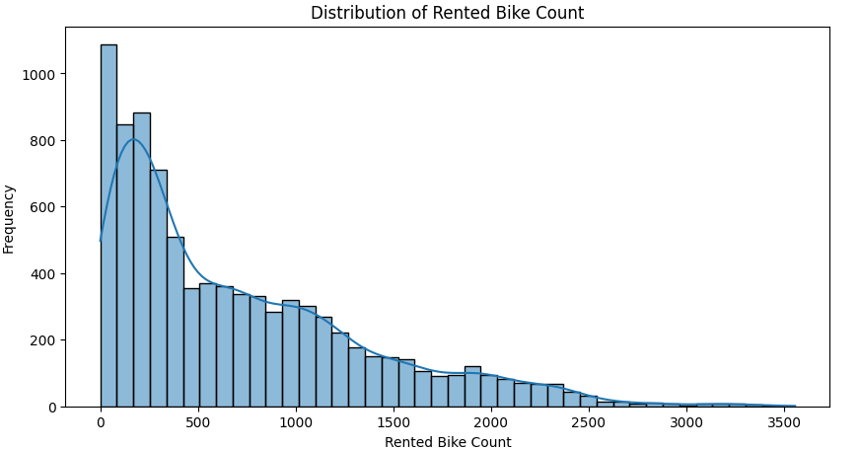
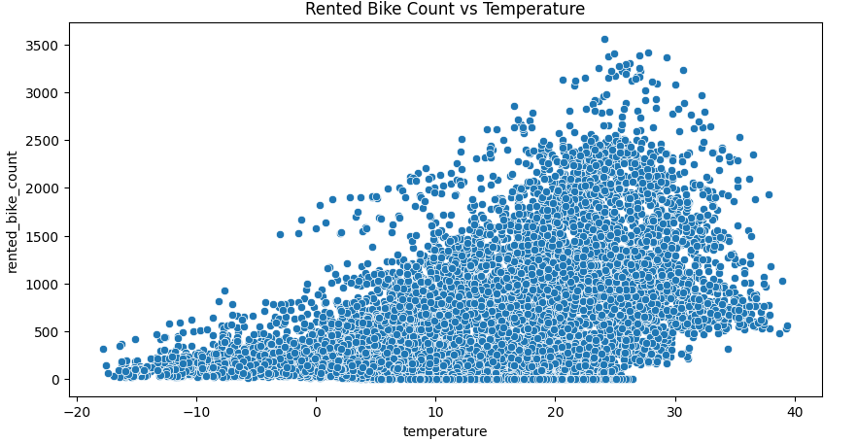
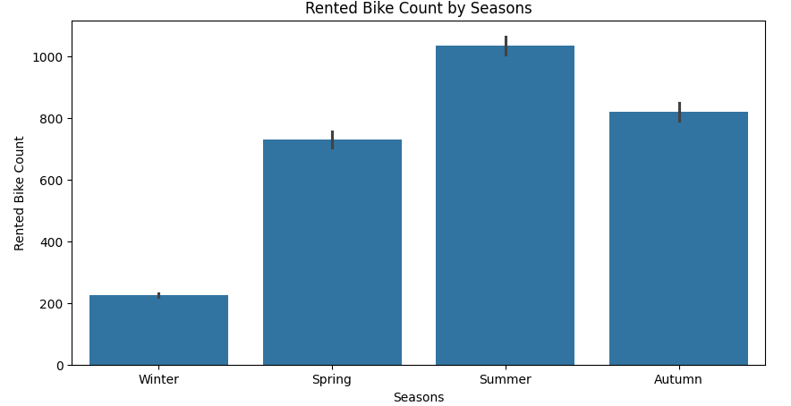
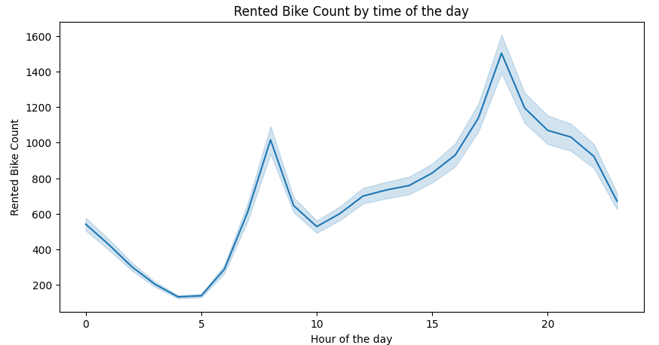
EDA:
Notes:
In EDA, we saw the distribution of targeted variables, relation between bikes getting rented with temperature, seasons, hour of the day, etc.

Slide 8
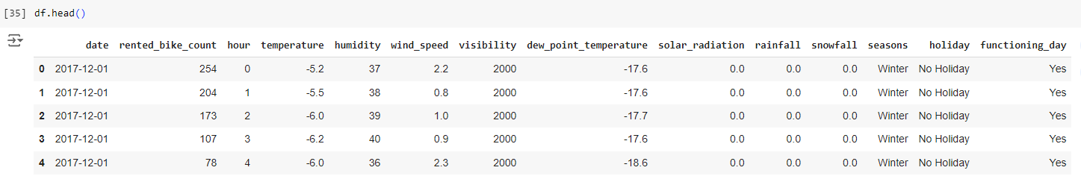
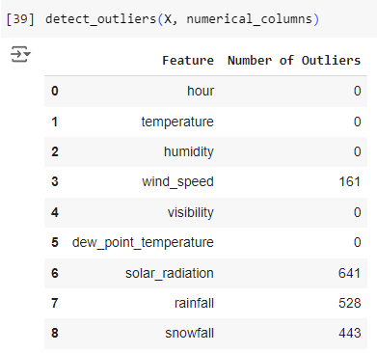
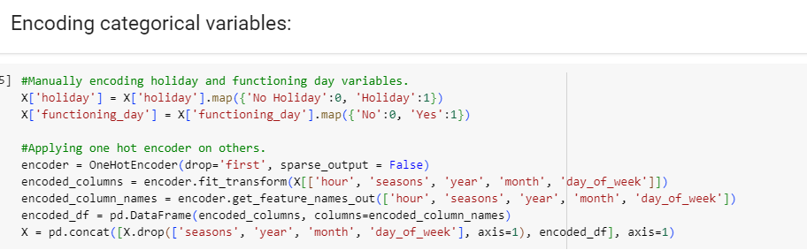
Data Preprocessing:

Slide 9
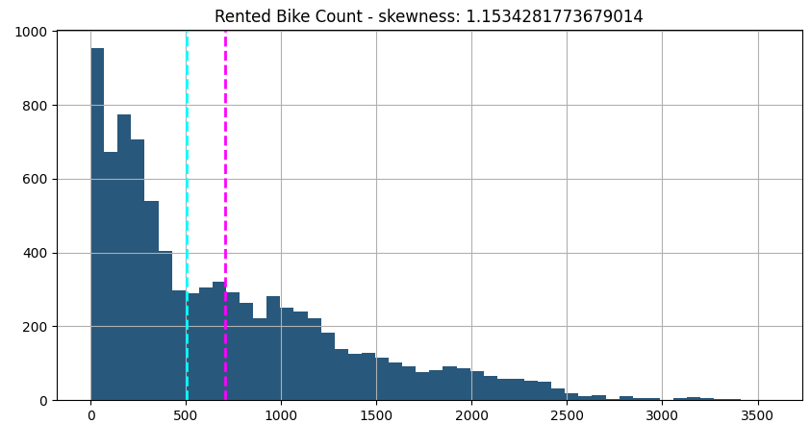
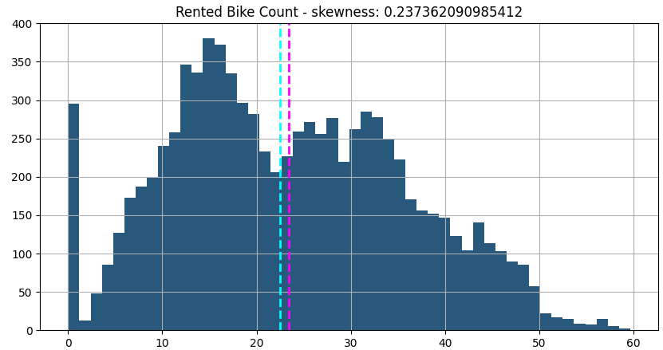
Data Transformation:

Slide 10
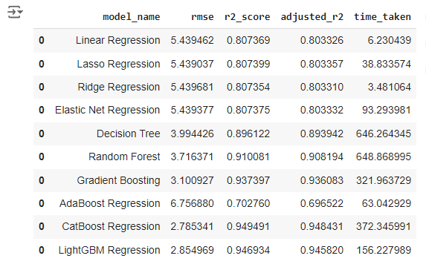
Data Modelling:

Slide 11
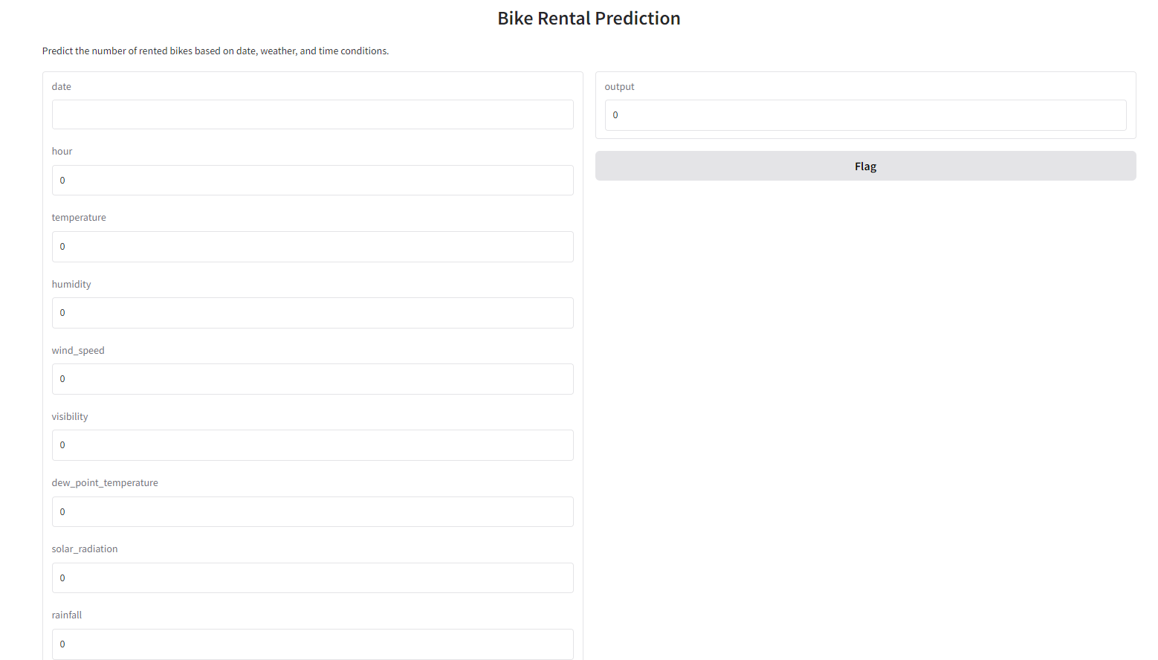
Deployment:

Slide 12
Business use case:
Resource Allocation: Help officials predict bike-sharing demand for effective resource management.
Strategic Insights: Provide insights on the impact of weather, time, and behavior on demand.
Service Optimization: Improve bike-sharing availability and user experience based on demand forecasts.

Slide 13
Conclusion:
This project leverages data-driven insights to improve bike-sharing demand prediction in Seoul. By analyzing weather, user behavior, and time factors, our machine learning models will accurately forecast usage. This empowers city planners to make informed decisions, optimize resources, and promote sustainable urban mobility, showcasing the impact of data analysis on enhancing transportation efficiency and reducing environmental impact.

Slide 14
Thank You!

